Slide 1
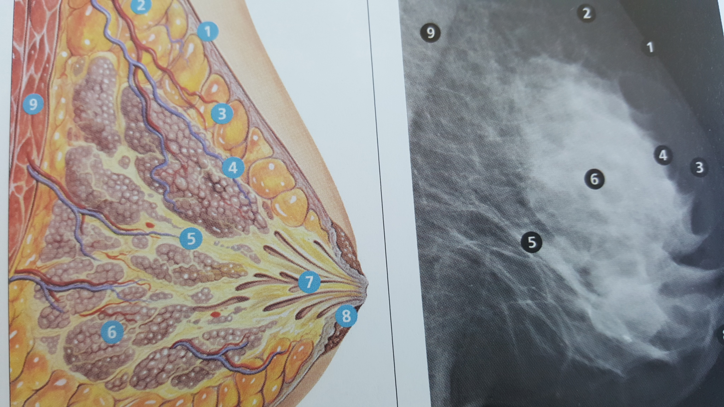

Slide 2
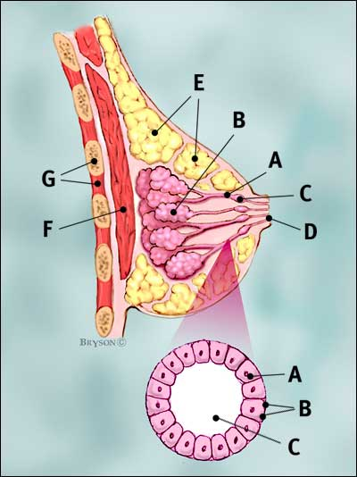
Normal Breast
Breast profile
A | ducts
B | lobules
C | dilated section of duct to hold milk
D | nipple
E | fat
F | pectoralis major muscle
G | chest wall/rib cage
Enlargement
A | normal duct cells
B | basement membrane (duct wall)
C | lumen (center of duct)
Illustration © Mary K. Bryson

Slide 3
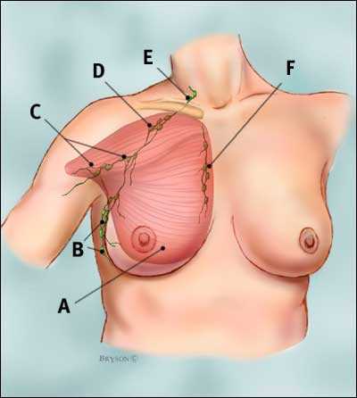
Regional Lymph Nodes for Breast
A: Pectoralis major muscle
B: Axillary lymph nodes level I
C: Axillary lymph nodes level II
D: Axillary lymph nodes level III
E: Supraclavicular lymph nodes
F: Internal mammary lymph nodes
Notes:
Points B, C, and D on this diagram are axillary lymph nodes. The level I nodes at point B are closest to the breast; the level II nodes at point C are further from the breast near the upper arm; and the level III nodes at point D are the axillary nodes furthest from the breast approaching the collarbone. Point E is the supraclavicular nodes, which are above the collarbone. Point F is the internal mammary nodes located near the sternum or breast bone.

Slide 4
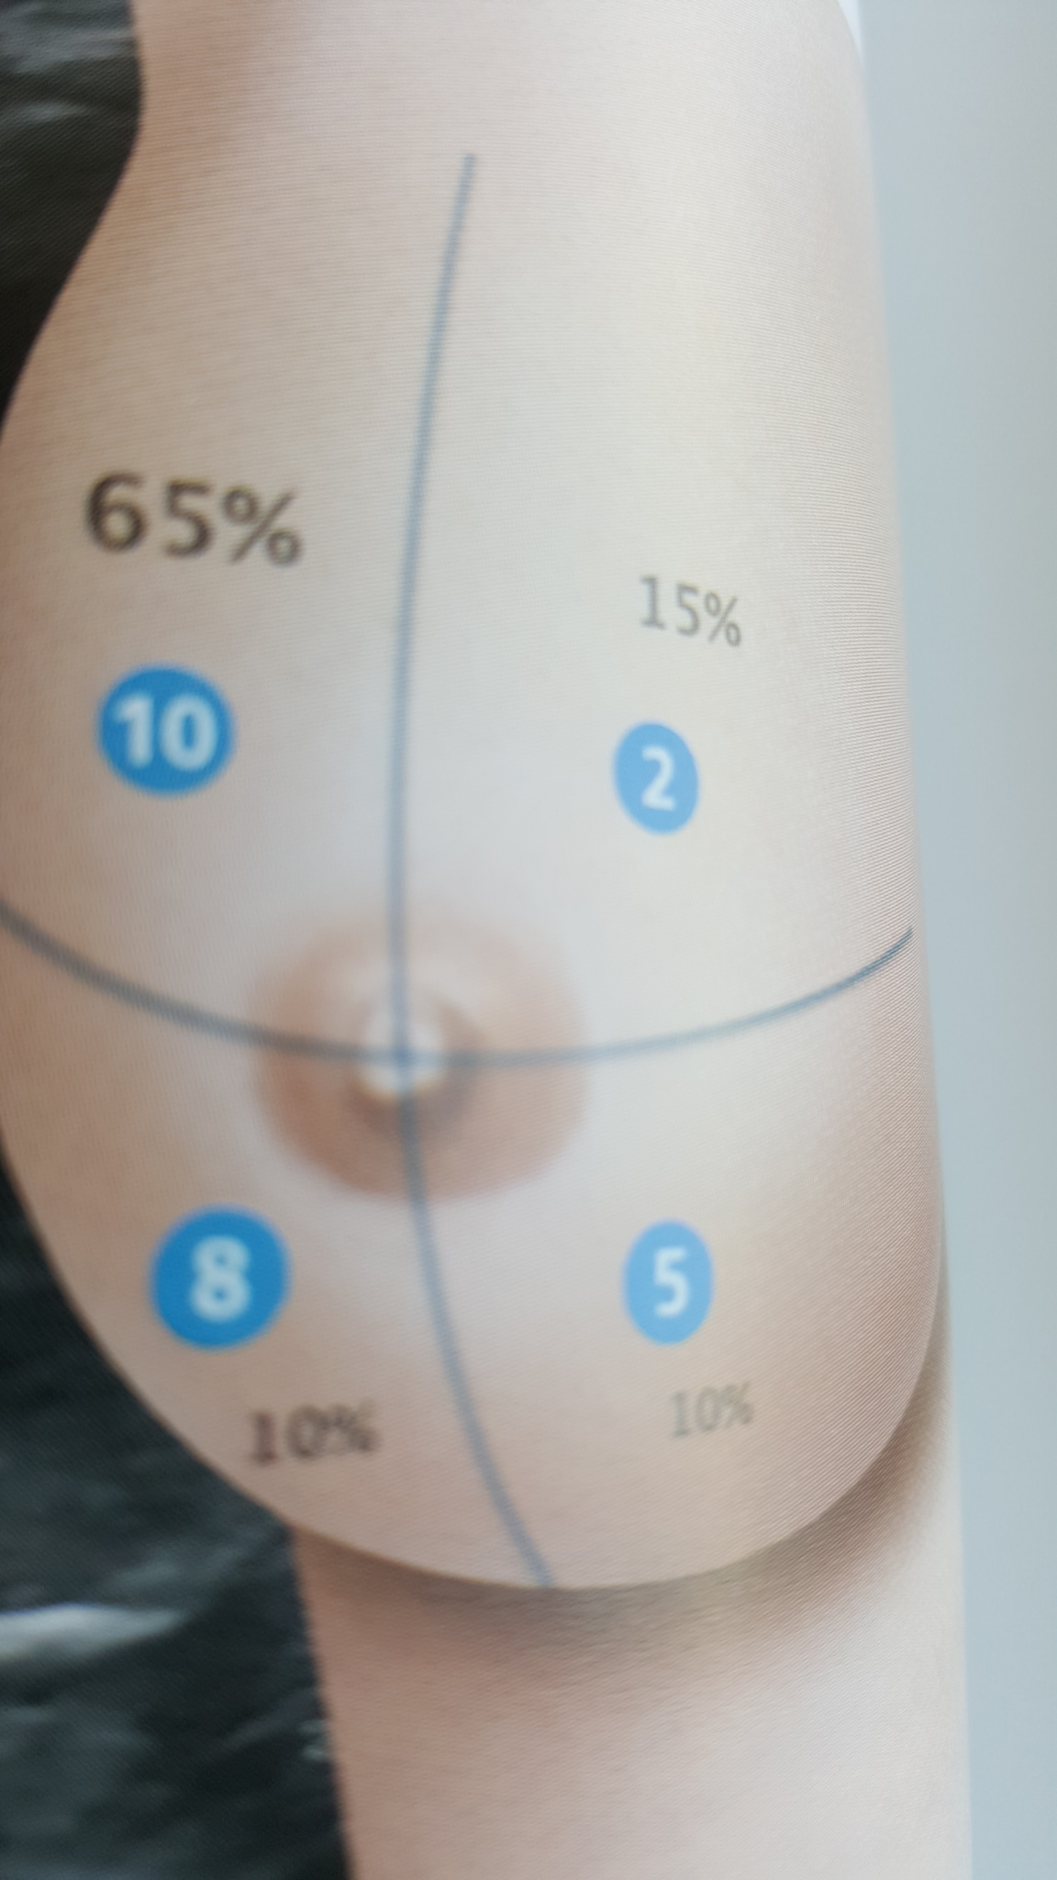

Slide 5
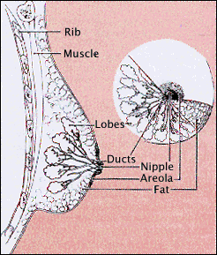
Breast Anatomy
Breast contains 15-20 lobes
Fat covers the lobes and shapes the breast
Lobules fill each lobe
Sacs at the end of
lobules produce milk
Ducts deliver milk to the
nipple
Notes:
Each breast contains 15 to 20 lobes. The lobes are covered and supported by connective tissue or fat. The fat gives the breast its size and shape. Each lobe contains lobules. At the end of the lobules are the sacs that produce milk. The milk is delivered to the nipple by ducts that convey it from the lobules. The breast tissue, which includes the lobes and connective tissue (fat), is covered by skin. The nipple is located on the skin of the breast. It’s function is expression of milk produced by the lobules. The pigmented area that surrounds the nipple is the areola.

Slide 6
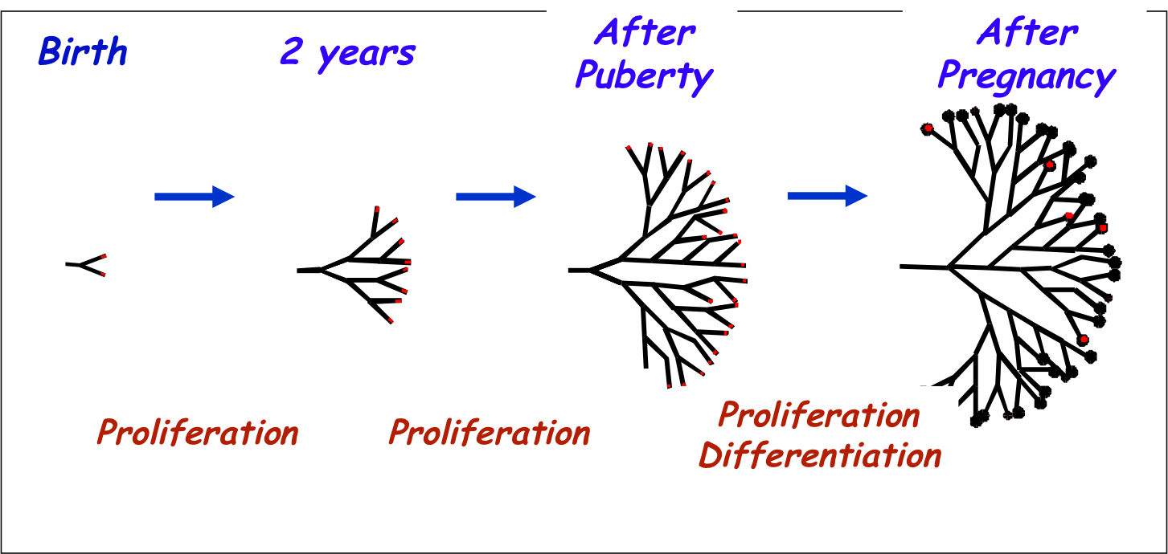
Development of the Breast Ductal Tree
Occurs mainly after birth

Slide 7
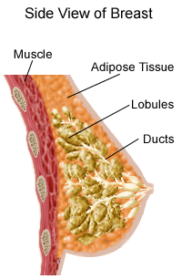
Stucture of the Breast
Breast has no muscle tissue
There are muscles underneath the breasts separating them from the ribs

Slide 8
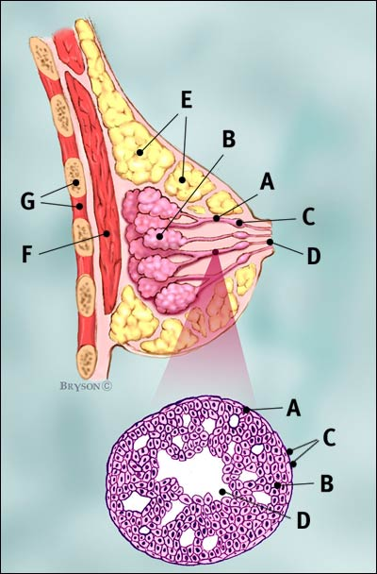
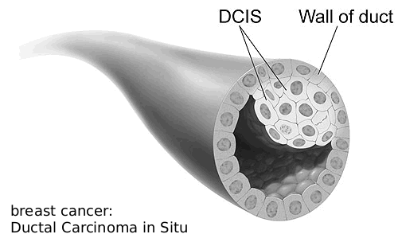
Ductal Carcinoma in situ (DCIS)
Ductal cancer cells
Normal ductal cell
Illustration © Mary K. Bryson

Slide 9
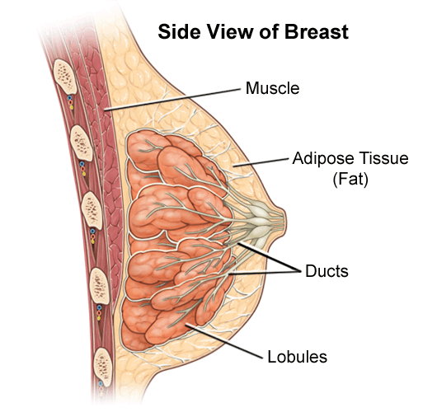
Female Breast Anatomy
The bulk of the breast tissue is adipose tissue interspersed with connective tissue
Breast ducts comprise only about 10% of the breast mass
lobes
ducts
lymph nodes

Slide 10
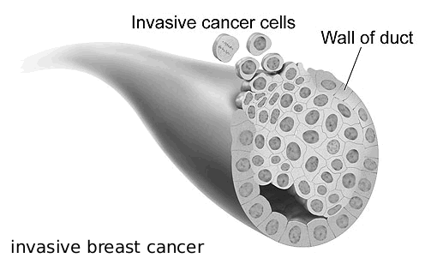
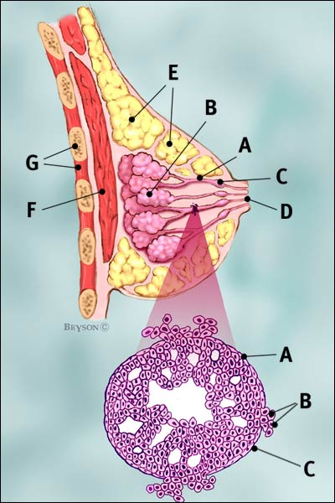
Invasive Ductal Carcinoma (IDC – 80% of breast cancer)
Ductal cancer cells breaking through the wall
The cancer has spread to the surrounding tissues
Carcinoma refers to any cancer that begins in the skin or other tissues that cover internal organs
Illustration © Mary K. Bryson

Slide 11
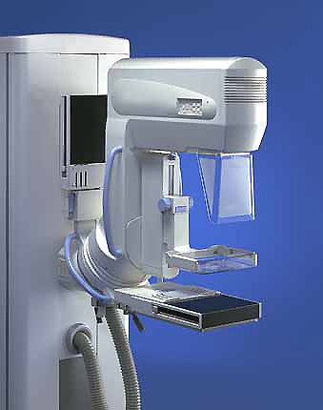
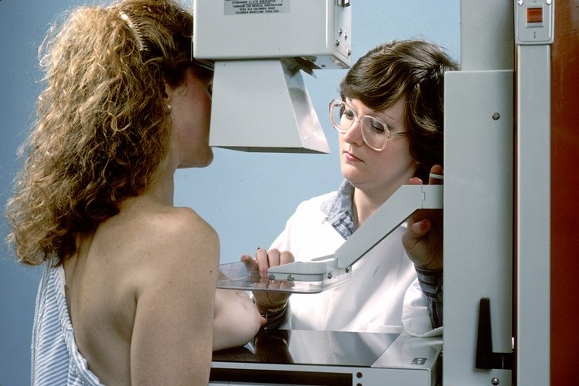
Mammography Equipment

