Slide 1

Notes:
The sweetest little snoogaboo you’ve ever laid eyes upon.
How many of you have grandchildren cuter than this baby?
I had a feeling a lot of you might. ☺
Now, from the day we are born, our genes are as good as they get. However, no one is genetically perfect

Slide 2
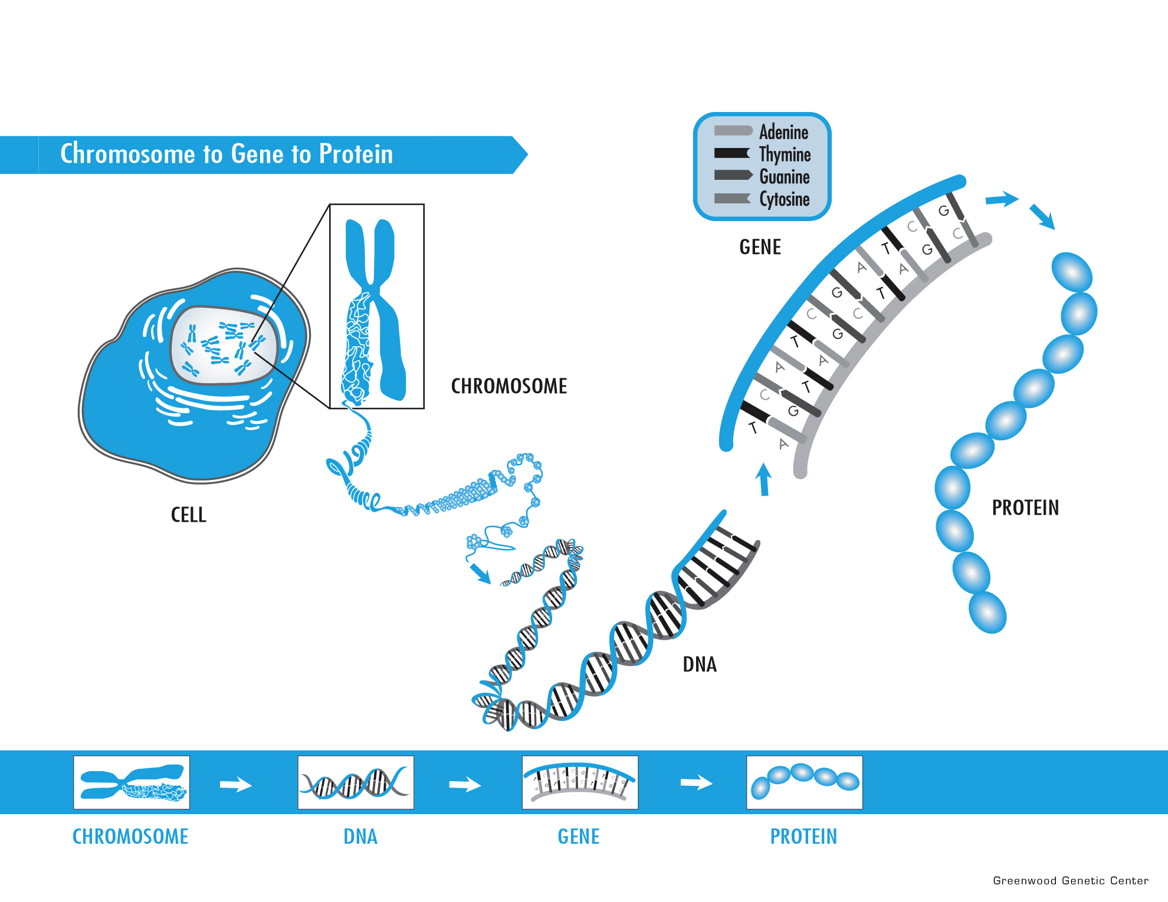
What is a Gene?
Notes:
You might have suspected there would be a biology lesson in today’s lecture. Now, some of you in the audience today have some scientific or medical background, so this may be very familiar to you. But for some of us, we haven’t had any biology or genetics education since school, if ever. So bear with me for a little overview here.
Our body is made up of billions of cells. Skin cells, heart cells, eye cells. Within the center of every cell are structures called chromosomes. CLICK
Chromosomes are made up of very, very long strands of DNA. CLICK Think of DNA like a book of recipes.
Sections of this DNA make up individual genes. CLICK We have about 20 thousand genes, or recipes, within every cell of our body. CLICK
The cell is able to read the recipes of our genes and build proteins that we need to function.
Genes determine our eye color and hair color, but they also control how cells live and die. The proteins that genes make, work with each other and they also interact with environmental influences.

Slide 3

Genetic information is key
Notes:
3
Genetics can help us identify the people who have risks for disease that go far above the general risks we all have based on our lifestyle and health choices we make.
Who are the people who will get heart disease no matter how many veggies they eat and marathons they run?
Who are the people who have such a risk for cancer that they should take extra steps to detect or prevent this disease?
This is where genetics and genetic testing plays a role in healthcare.

Slide 4
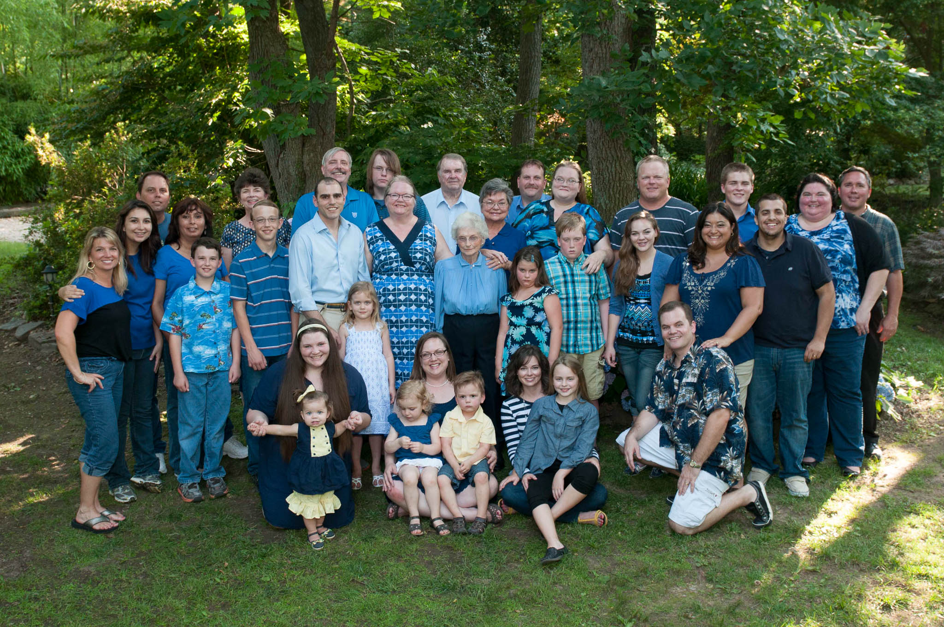
Top 5 Reasons to Know Your Family History
5. Family recipes should be kept secret — family medical history should not.
4. Knowing your risk might save your life.
3. It’s free and you don’t have to leave home.
2. It’s a priceless gift to leave to your children.
1. Because every family has a story, but not every family has YOUR story.
https://www.yahoo.com/health/10-reasons-you-should-dig-into-your-family-medical-118232923367.html
Notes:
This is my extended family starting with my 90 year old great grandmother there in the middle.
5. Family recipes should be kept secret — family medical history should not.
4. Knowing your risk might save your life.
3. It’s free and you don’t have to leave home.
2. It’s a priceless gift to leave to your children.
1. Because every family has a story, but not every family has YOUR story.

Slide 5
Frequency of cell division
Frequency of cell division varies with cell type
  skin cells
    divide frequently throughout life
  liver cells & muscle, bone
    retain ability to divide, but keep it in reserve
  mature nerve cells do not divide at all after maturity
Notes:
This question, whether muscles grow through hypertrophy (increased cell size) or hyperplasia (increased cell number), has been debated for years, and has only recently been answered adequately. The answer is: normal exercise causes hypertrophy, whereas overexertion, or any exercise that injures the muscles, results in both hypertrophy and hyperplasia.First, some background on muscle cells. During development, muscles are formed from aggregation and proliferation of pre-myoblasts (migratory pre-muscle cells) to form "pre-muscle masses." After forming these masses, the pre- myoblasts turn on several of the genes required to form muscles, becoming myoblasts (pre-muscle cells). The myoblasts then fuse together to form giant, multinucleated cells called myotubes. The myotubes continue to grow, but only through the addition of more myoblasts, until each contains many, many nuclei. Eventually, the myotubes accumulate enough contractile proteins to build myofibrils (the biochemical motors that make muscles work) which completely fill the myotubes, pushing the nuclei to the edges of the tube. Once this machinery is complete, the myotubes become myofibers, which are the "muscle cells" in adult muscles. The myofibers continue to grow, though - by increasing the numbers of myofibrils in each cell, the myofibers can grow to many times their original size. But, with multiple nuclei and essentially solid cytoplasms, it is impossible for myofibers to divide through mitosis (even more so, since the nuclei lost their ability replicate before the myotubes fused). So the only way to get more myofibers is to fuse more myoblasts, but all of the myoblasts were used by the embryo to form the original muscles.That's not entirely true. The exception is a small population of satellite cells which lie dormant next to the myofibers. They lie dormant until something happens that destroys part of the nearby muscle. The body's response to the injury activates the satellite cells which reproduce very quickly and then differentiate into myoblasts which fuse to form new myotubes, and eventually myofibers, at the site of injury to replace the muscle that was damaged. However, this only occurs when there is injury. Since normal exercise doesn't (or at least, shouldn't) involve damaging muscles, the satellite cells are never activated, so no new muscle cells are produced.

Slide 6
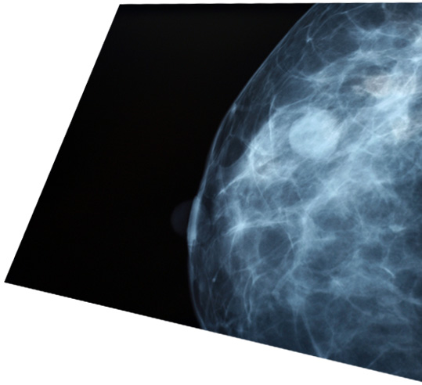
Most Common Screening Tests
Mammography
Clinical breast exam
Breast self-exam
Notes:
The three tests most commonly used to screen for breast cancer are mammography, the clinical breast exam, and the breast self-exam.

Slide 7
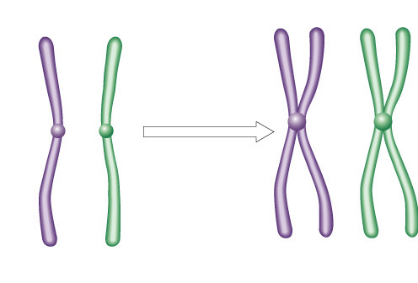

Cell Cycle Control
Two irreversible points in cell cycle
  replication of genetic material
  separation of sister chromatids
Cell can be put on hold at specific checkpoints
sister chromatids
There’s no
turning back,
now!
centromere
single-stranded
chromosomes
double-stranded
chromosomes

Slide 8
BRCA genetic testing
BRCA genetic testing is available to anyone in Australia through private laboratories. BRCA gene testing costs differ between laboratories and start from approximately $900. Although genetic testing is accessible and becoming increasingly cheaper it is not always helpful in clarifying the risk of breast and ovarian cancer for many people.

Slide 9
Familial Breast Cancer
Cause 5-10% of all cancer and 25% in women <30 y/o
BRCA2
    Causes 40% of familial breast CA
    50-70% - breast
    15-45% - ovarian
    Increased risk for prostate, colon
BRCA1
    50-70% - breast
    20-30% - ovarian
    Increased risk for prostate, pancreatic, laryngeal,
Notes:
Review article from Netherlands group

Slide 10
BRCA genetic testing
BRCA genetic testing is available to anyone in Australia through private laboratories. BRCA gene testing costs differ between laboratories and start from approximately $900. Although genetic testing is accessible and becoming increasingly cheaper it is not always helpful in clarifying the risk of breast and ovarian cancer for many people.

Slide 11
Why can’t everyone have free BRCA genetic testing?
Although, gene testing can be helpful it does not always provide all the answers needed to help clarifying a woman’s level of breast or ovarian cancer risk. Only 5% of women who develop breast cancer have a high risk breast cancer gene involved and of women with breast cancer who also have a familial breast cancer cluster 84% of those women do not have a BRCA gene mutation.

Slide 12
Why can’t everyone have free BRCA genetic testing?
Although, gene testing can be helpful it does not always provide all the answers needed to help clarifying a woman’s level of breast or ovarian cancer risk. Only 5% of women who develop breast cancer have a high risk breast cancer gene involved and of women with breast cancer who also have a familial breast cancer cluster 84% of those women do not have a BRCA gene mutation.

Slide 13
Common Risk Factors
Age
Family history
Ethnicity
Lifestyle
Diet
Alcohol
Smoking
Notes:
THESE (CLICK) we have some control over. These same factors appear in study after study and lecture after lecture by your doctor. Believe it or not, an overall healthy lifestyle will lead to a healthier life although it still doesn’t guarantee that disease will never happen. Regular exercise, diets based on fruits and vegetables and lean proteins, limited alcohol use and no smoking. We all know this and we do our best to various degrees of success. CLICK
But why are these things so important? Because over time these things start to damage those happy, healthy cells we were born with. And when a cell becomes too damaged, it usually dies. A few dead cells out of billions is not so bad, but this accumulates over time and can begin to manifest as heart, bone, or lung disease or other issues.
But what about THESE risk factors? (CLICK) We don’t have much control over growing older or what our family history looks like. How do these influence disease?

Slide 14
Personal Cancer Risk
Family History
Lifestyle
Environ-ment
Genetics
Aging
Chance
Notes:
When we look at cancer specifically, we see many of those same risk factors we talked about before. Age, lifestyle, and to some extent, genetics

Slide 15

Isn’t it just a blood test?
Positive results with limited information
Inconclusive results
Results that don’t “fit”
Worry/anxiety

Slide 16
Hereditary breast and ovarian cancer syndrome caused by mutations in BRCA1 and BRCA2 genes
Autosomal dominant cancer predisposition syndrome
Associated with high risk for breast and ovarian cancers and a moderate risk for other cancers
Not all individuals who inherit a mutation in BRCA1 or BRCA2 will develop cancer (reduced penetrance) and the signs, symptoms, cancer type, and age of onset of cancer will vary within families (variable expressivity).

Slide 17
Breast CA
Ovarian CA
Ov Ca
Died 48
Prostate CA
Ov Ca
Dx 40
BRCA1 pos
BRCA1 pos
BRCA1 pos
BRCA1 neg
33
Prostate Ca
Dx 43
BRCA1 pos
Bilateral Br Ca
Dx 30, 2nd Dx 35
Jenny
BRCA1 pos
Jenny has a 50% chance to inherit the familial BRCA1 gene mutation from her father
Notes:
Example to illustrate reduced penetrance, variable expressivity and AD transmission

Slide 18


Who should be offered genetic testing/consultation?
Breast cancer diagnosis at a young age (<35-45 years) [both invasive and ductal carcinoma in situ]
Ovarian cancer at any age [epithelial]
Male breast cancer
Multiple primaries in the same individual
    e.g. bilateral breast cancer (particularly if the diagnosis was before age 50), breast and ovarian cancer
Breast cancer diagnosis AND a family history of 2+ additional HBOC- related cancers, including breast, ovarian, prostate (Gleason ≥7) and pancreatic cancer
High risk ethnicity (Ashkenazi Jewish, Icelandic) and a personal and/or family history of HBOC-related cancer
Triple negative breast cancer diagnosed <age 60
OR
Probability of 10% or higher to carry a BRCA mutation

Slide 19
Genetics of hereditary breast and ovarian cancer syndrome
BRCA1 (chrom 17) and BRCA2 (chrom 13) are tumor suppressors
Mutation leads to inability to regulate cell death and uncontrolled growth
>2600 mutations
Carrier frequency of BRCA1 & BRCA2 mutations
  1/300 to 1/500 in general population
  1/40 - 1/50 in Ashkenazi Jewish population
    3 common mutations in Ashkenazi Jews

Slide 20
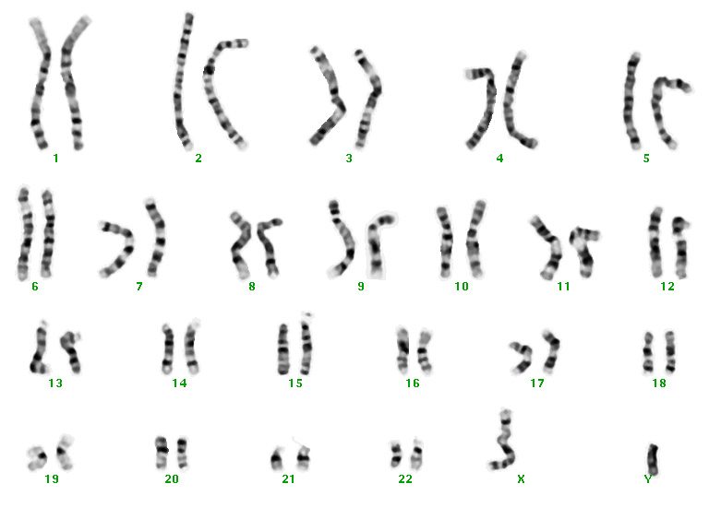
DAD
MOM
Notes:
You end up with 23 pairs of chromosomes holding all of our genetic material.
CLICK You get one of each pair from mom and one of each pair from dad.
This one cell starts to divide and divide and divide until you end up with…

Slide 21
Consequences of having a BRCA mutation
Cancer type | Cancer risk in a mutation carriers of: |  | General Population
 | BRCA1 | BRCA2
Cumulative lifetime invasive breast cancer risk in women (by age 70) | 57% | 49% | ~12%
Cumulative lifetime ovarian cancer risk (by age 70) | 40% | 18% | ~1.3%
Cumulative lifetime breast cancer risk in men (by age 70) | Increased (controversial) | 6-7% | 0.1%
Lifetime prostate cancer risk (by age 70) | n/a | 2-6x increased risk | ~14%
Carroll CMAJ 2012
Notes:
21

Slide 22
Screening and Surveillance for BRCA gene mutation carriers
    Increased surveillance
      MRI + mammography from age 25-30
    Chemoprevention
      Selective estrogen receptor modulators (SERMs) i.e. Tamoxifen/Raloxifene ~50% reduction in RR of breast cancer; reduce BrCA risk in healthy BRCA2 carriers by ~60%
      Aromatase inhibitors (exemestane, anastrozole, letrozole) under investigation
    Risk-reduction surgery
      Bilateral mastectomy: ~ 90% risk reduction in Br Ca
      Bilateral salpingo-oophorectomy (BSO): 80% reduction in risk of ovarian/fallopian tube cancer; 50% reduction in risk of BrCA; Optimal age of BSO=pre-menopause

Slide 23
What do the genetic test results mean?
Positive test result: Gene mutation known to be pathogenic found
The patient has an increased lifetime risk to develop certain cancers
Screening and surveillance recommendations to improve outcome
Family members are at risk of carrying the same mutation and of having similar cancer risks

Slide 24
Treatment options for affected BRCA mutation carriers
More frequent, or intensive cancer screening
Risk-reducing medications
  e.g. tamoxifen or raloxifene
Risk-reducing surgery
  e.g. mastectomy or bilateral salpingo-oophorectomy(BS0)
New adjuvant, neoadjuvant, and metastatic treatments
  e.g. PARP inhibitors
Moyer Ann Intern Med 2014, Livraghi and Garber BMC Medicine 2015
Notes:
Mean cumulative risks of contralateral BrCA by age 70 for BRCA1 carriers was a 83% and 62% for BRCA2 carrier.
Poly(ADP-ribose) polymerases (PARP) are enzymes involved in DNA-damage repair. Inhibition of PARPs is a promising
strategy for targeting cancers with defective DNA-damage repair, including BRCA1 and BRCA2 mutation-associated
breast and ovarian cancers.

Slide 25
Screening and Surveillance for BRCA gene mutation carriers
    Lifestyle modification
      Maintain healthy lifestyle with proper diet, healthy BMI, regular exercise and limited alcohol consumption
      Stay up-to-date on current screening recommendations
    Prostate CA
      Consider screening beginning at age 40 (e.g. annual digital rectal examination +/- PSA)
      A number of retrospective studies consistently report that BRCA2 carriers present at a younger age with aggressive disease, higher rates of lymph node involvement, distant metastasis at diagnosis, and a higher mortality rate compared with non-carriers
      BRCA1 cancer risk is thought to also be increased, although controversial
Notes:
NCCN Clinical Practice Guidelines in Oncology (NCCN Guidelines®) for Genetic/familial high risk assessment: Breast and ovarian V.1.2015© National Comprehensive Cancer Network, Inc 2015. All rights reserved. Accessed [26/05/2015]. To view the most recent and complete version of the guideline, go online to www.nccn.org. NATIONAL COMPREHENSIVE CANCER NETWORK®, NCCN®, NCCN GUIDELINES®, and all other NCCN Content are trademarks owned by the National Comprehensive Cancer Network, Inc.
“Starting at age 40y –Recommend prostate cancer screening for BRCA2 mutation carriers; consider prostate screening for BRCA1 carriers” pg MS-5 describes studies showing PrCA in BRCA2 mutation carrier is more aggressive and associated decreased survival.
Mersch 2015 Cancers associated wtih BRCA1 and BRCA2 mutations other than breast and ovarian CANCER “Prostate cancer occurred approximately 5 times more frequently in males with BRCA2 mutations than expected in the general population. The increased risk for prostate cancer in our study population is consistent with previous studies, which have reported relative risk estimates ranging from 2.5 to 6.3. Our findings support the rationale for pancreatic and prostate cancer screening in individuals with a BRCA2 mutation….These suggestions [NCCN] currently include digital rectal examination and prostate-specific antigen serum testing beginning at the age of 40 years.”
Berliner JL, Fay AM, Practice Issues Subcommittee of the National Society of Genetic Counselors' Familial Cancer Risk Counseling Special Interest Group. Risk assessment and genetic counseling for hereditary breast and ovarian cancer: recommendations of the National Society of Genetic Counselors. J Genet Couns 2007; 16(3):241-60. “Follows NCCN guidelines”
Men with a BRCA1 or BRCA2 mutation are at increased risk for early onset, aggressive prostate cancer compared to men in the general population. Standard of care screening for men with a BRCA mutation includes PSA testing and digital rectal examination (DRE), the same as with men in the general population. This study is being done to assess whether there is value in using MRI as a screening tool to detect prostate cancer at an earlier stage than may otherwise be detected using standard of care screening (PSA, DRE). It is unclear whether MRI has utility as a screening tool in this specific population at high risk for aggressive disease. - Sunnybrook Health Sciences Centre
Women's College Hospital - Principal Investigator(s):Danny J Vesprini, MD, MSc, FRCPC, Shttp://www.ontario.canadiancancertrials.ca/trial/Default.aspx?TrialId=NCT01990521&lang=en

Slide 26
What do the genetic test results mean?
Variant of uncertain significance (VUS): a gene change that has not yet been categorized as benign or as pathogenic
The diagnosis of hereditary breast and ovarian cancer syndrome is neither confirmed nor ruled out
Some variants may be interpreted as ‘likely pathogenic’, generally meaning greater than 90% certainty of being disease causing
  Screening and management may be modified
  Other family members may be offered genetic testing to try to track the familial gene change and to see if it is associated with cancer

Slide 27
What do the genetic test results mean?
Variant of uncertain significance (VUS): a gene change that has not yet been categorized as benign or as pathogenic
Variants are periodically re-classified and patients are often encouraged to recontact their genetics clinic
Other hereditary cancer syndromes may be considered
Screening recommendations will be based on a combination of factors, such as family history and information about the VUS

Slide 28

Risks/Benefits/Limitations of Genetic Testing
Positive test result: Gene mutation known to be pathogenic found
Potential Benefits:
Clinical intervention may improve outcome
Family members at risk can be identified
Potential Risks:
Adverse psychological reaction
Family issues/distress
Uncertainty -incomplete penetrance
Insurance/job discrimination
Confidentiality issues

Slide 29
Risks/Benefits/Limitations of Genetic Testing
Negative test result: Familial mutation not found (true negative)
Potential Benefits:
Emotional - relief
Children can be reassured
Avoidance of unnecessary clinical interventions
Potential Risks:
Adverse psychological reaction (i.e. survivor guilt)
Complacent attitude to health

Slide 30

Case 1: Judy
Multiple affected relatives
Closely related
More than 1 generation affected
Early age of onset
Clustering of related cancers

Slide 31
What do the genetic test results mean?
Negative test result: affected patient no mutation identified and there is no known familial mutation
This result is uninformative
The diagnosis of hereditary breast and ovarian cancer syndrome is neither confirmed nor ruled out

Slide 32
Autosomal dominant inheritance
mother father
child
child
Each child has 50:50 chance of inheriting the altered gene.

Slide 33
Sporadic cancer
1 normal gene
1 mutated gene
cancer
2 normal genes
2 mutated genes
hormones
viruses chemicals
radiation
Spontaneous mutations
Inherited cancer
1 normal gene
1 mutated gene
cancer
2 mutated genes
hormones
viruses chemicals
radiation
Spontaneous mutations
Notes:
Knudson’s theory
2 hit hypothesis

Slide 34
Searching for the faulty gene
cgattgagg
atcgtacgta
ttaacggtag
ctataccagtc
gatccattgga
gtcatcgatgtt
cgattgagg
atcgtacgta
ttaacggtag
ctataccagtc
gatccattgga
gtcatcgatgtt
cgattgagg
atcgtacgta
ttaacggtag
ctataccagtc
gatccattgga
gtcatcgatgtt
cgattgagg
atcgtacgta
ttaacggtag
ctataccagtc
gatccattgga
gtcatcgatgtt
cgattgagg
atcgtacgta
ttaacggtag
ctataccagtc
gatccattgga
gtcatcgatgtt
cgattgagg
atcgtacgta
ttaacggtag
ctataccagtc
gatccattgga
gtcatcgatgtt
cgattgagg
atcgtacgta
ttaacggtag
ctataccagtc
gatccattgga
gtcatcgatgtt
cgattgagg
atcgtacgta
ttaacggtag
ctataccagtc
gatccattgga
gtcatcgatgtt
a
cgattgagg
atcgtacgta
ttaacggtag
ctataccagtc
gatccattgga
gtcatcgatgtt
cgattgagg
atcgtacgta
ttaacggtag
ctataccagtc
gatccattgga
gtcatcgatgtt
cgattgagg
atcgtacgta
ttaacggtag
ctataccagtc
gatccattgga
gtcatcgatgtt
cgattgagg
atcgtacgta
ttaacggtag
ctataccagtc
gatccattgga
gtcatcgatgtt
cgattgagg
atcgtacgta
ttaacggtag
ctataccagtc
gatccattgga
gtcatcgatgtt
cgattgagg
atcgtacgta
ttaacggtag
ctataccagtc
gatccattgga
gtcatcgatgtt
cgattgagg
atcgtacgta
ttaacggtag
ctataccagtc
gatccattgga
gtcatcgatgtt

Slide 35
Genetic Testing
Technically difficult
Can only be offered to high risk families
Can only search small number of high risk dominant genes
Can take more than a year to search for the mutation in a family
Often cannot locate the mutation for a family (?unknown genes)

Slide 36
Genetic Testing
First test in family always done on person who has had the cancer (mutation search test)
If no living affected relatives available – cannot offer genetic test for family
If a mutation is found predictive testing can be offered to at-risk relatives:
  If relative doesn’t carry familial mutation they are not at increased risk of cancer (still at population risk)
  If a person does carry the familial mutation they are at increased risk of developing cancer

Slide 37
Recent NICE Guidelines on Familial Breast Cancer
Women at or near population risk are cared for in primary care.
Women at moderate risk are cared for in secondary care.
Women at high risk are cared for in tertiary care.

Slide 38
High Risk
Cancer risks associated with
BRCA1 and BRCA2
Breast and ovarian cancer
Breast cancer risk ~80%
Ovarian cancer risk ~45%
Increased risk of second primary for women who have already had breast cancer
Other cancers
Prostate cancer
Male breast cancer
Pancreatic cancer
Colorectal cancer
Stomach cancer

Slide 39
