Slide 1
Amirkabir imaging center dr.m.ali mohammadi
2011

Slide 2
Synonym: Two- vessel cord.
Definition: Absence of one umbilical artery.
Etiology: Single umbilical artery affect about 7% of pregnancies and about 1% live births.
- Caucasian women are twice as likely to experience this complication as compared to Japanese and Black women.

Slide 3
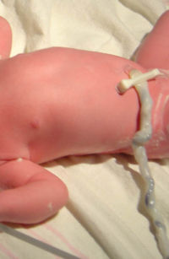
Other factors that increase the risk are:
- Advance maternal age ( over 40yrs)
- High parity
- Multiple gestation
- Diabetes
- Female fetal sex
- IUGR
Affect either artery, but left
artery tends to be more
absent than right.

Slide 4

Pathogenesis: Exact cause is unknown. Three theories have been proposed.
1.Primary agenesis of one of the umbilical arteries.
2. Atrophy of one artery.
3.Failure of division of the transient primordial umbilical artery.

Slide 5
Sonographic evaluation of SUA:
Real- time ultrasound imaging will demonstrate one abnormally large artery and only two vessels visible instead of three.
Ultrasound is the most accurate diagnostic tool, about 90% accurate with some low false positive rate even with experienced operators.
About 66% accurate at 16-17wks.
About 97% accurate at 18-20 wks.

Slide 6
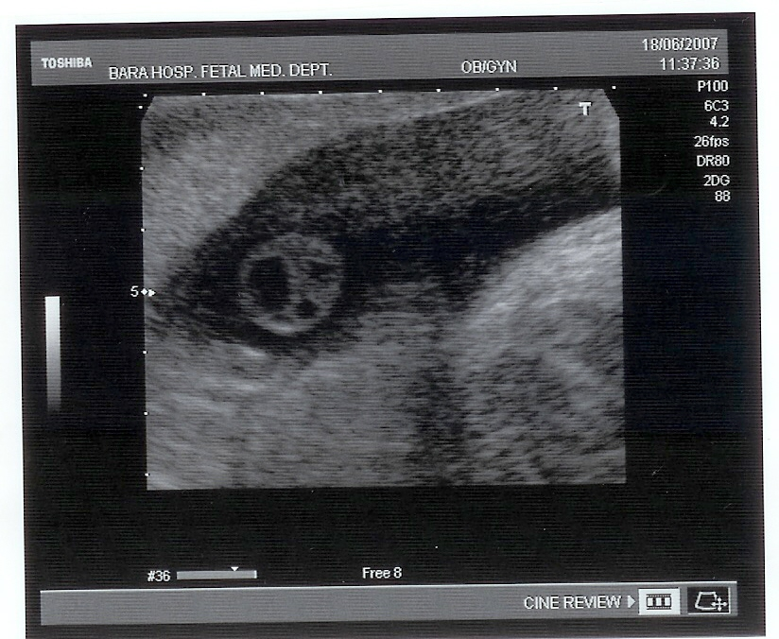
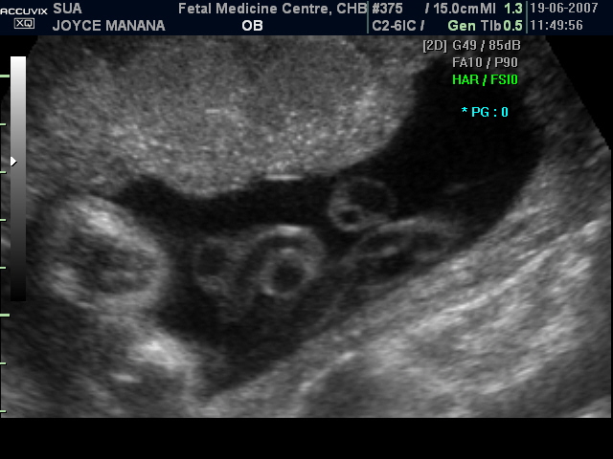

Slide 7
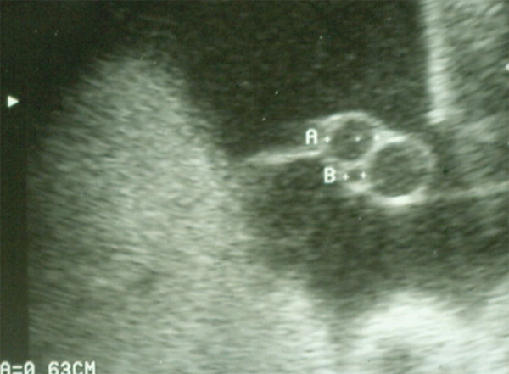
Atrophied artery

Slide 8
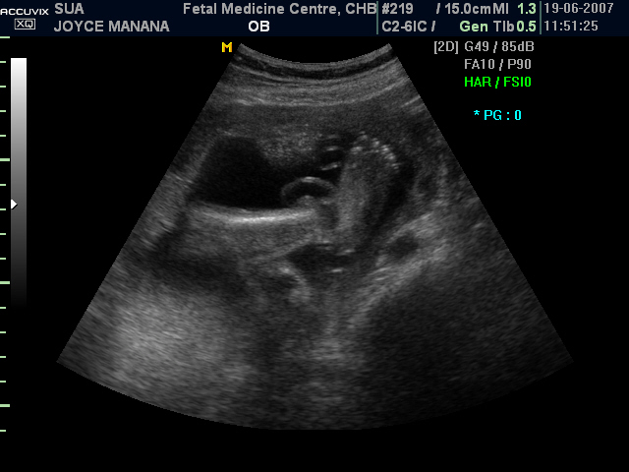
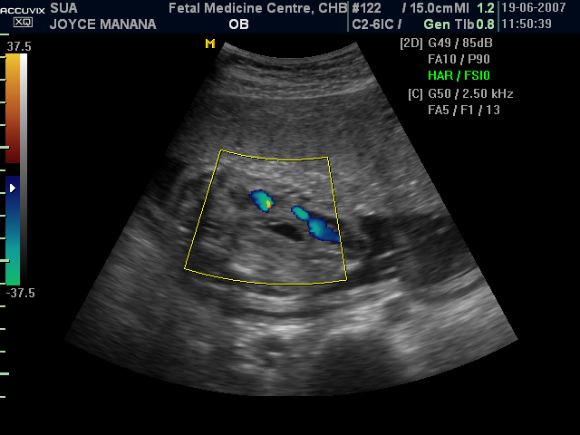

Slide 9
Diagnosis can be affected by several factors:
Maternal obesity.
Maternal abdominal scar.
Gestational age.
Amniotic fluid amount (oligohydramnios).
Fetal position.
Vessel tortuosity.
Scanning experience.
Lateral resolution of the equipment.

Slide 10
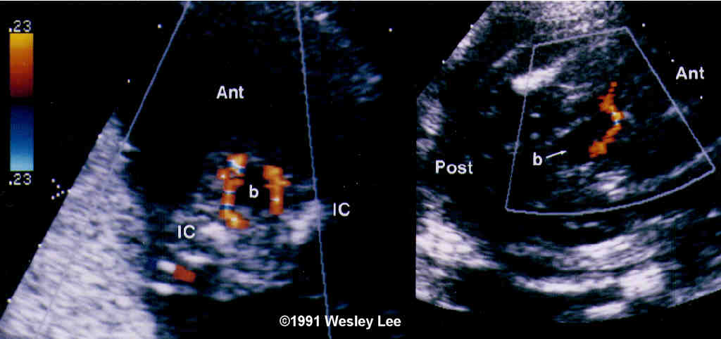
Color doppler
Reliable by at least from 16 weeks of gestational age.
Doppler velocity best detected when the angle of insonation is parallel to the blood flow.

Slide 11
Associated anomalies:
About 2/3 of babies born with SUA are healthy with no chromosomal or structural congenital abnormalities.
Of the remaining babies with SUA about 30% will be born with chromosomal abnormalities like trisomy 13,18 & 21.
The most common congenital abnormalities:
Heart defects, gastrointestinal tract, central nervous system, genitourinary tract system, respiratory system and musculoskeletal.

Slide 12
Associated anomalies cont.
Aside from these anomalies, between 15% & 20% fetuses with SUA will suffer from:
- IUGR.
Miscarriage rate of about 22% is associated with SUA likely due to increased abnormalities.
IUFD or Neonatal death.
Associated with low birth weight (<2500g).
Preterm delivery(< 37 wks).

Slide 13
Differential diagnosis: None.
Prognosis: Depend on the associated anomalies if present.
Recurrence risk: Unknown.
Management: Depends on the associated anomalies if present.
Echocardiogram – to asses functioning of the heart.
If isolated- follow up ultrasound scans required towards term to monitor fetal growth.
Post natal evaluation – asses renal functioning. They have high risk of urinary infections.

Slide 14
DISCUSSION
Screening infants with an isolated SUI for renal anomalies. Essential?
Study done by Anatomical Pathology JHB Hospital institute of medical research & University of Witwatersrand ( SA) over one year period July 2000 – July 2001:
About 15 still born fetuses were autopsied.
Maternal age range from 20 - 35 years.
GA from 17 – 36 wks.

Slide 15
Apart from common other malformations like NTD, chromosomal and structural abnormalities,
Five cases ➔bilateral or unilateral cystic renal dysplasia.
Two of the above cases ➔ posterior urethral valves.
Two cases ➔ additional of Potter’s sequence.
One case ➔ Meckel’s syndrome.
These abnormalities thought to be due to obstruction to the urinary outflow resulting to cystic renal dysplasia or resulting from ischaemia due to SUA.

Slide 16
Conclusion from above: Post natal renal evaluation is essential.
B. Study published by Department of Pediatrics ( Beatrix Children Hospital) Netherlands in November 2006 :
Some studies advise to perform renal ultrasound in infants born with an isolated SUA due to its association with silent renal anomalies.
Conclusion : It is unnecessary to screen for renal anomalies without other anomalies seen at physical examination.

Slide 17
IS IT NECESSARY TO SCREEN POSTNATALY ?

Slide 18
THANK YOU!

